Slide 1

A sports robot
PEOPLES FRIENDSHIP UNIVERSITY OF RUSSIA NAMED AFTER PATRICE LUMUMBA
teacher
MADE BY NIKITA DEMIDOVICH AND ARTYOM OLEYNIK
NKABD- 01 - 22 & NKABD- 03 - 22
2023

Slide 2

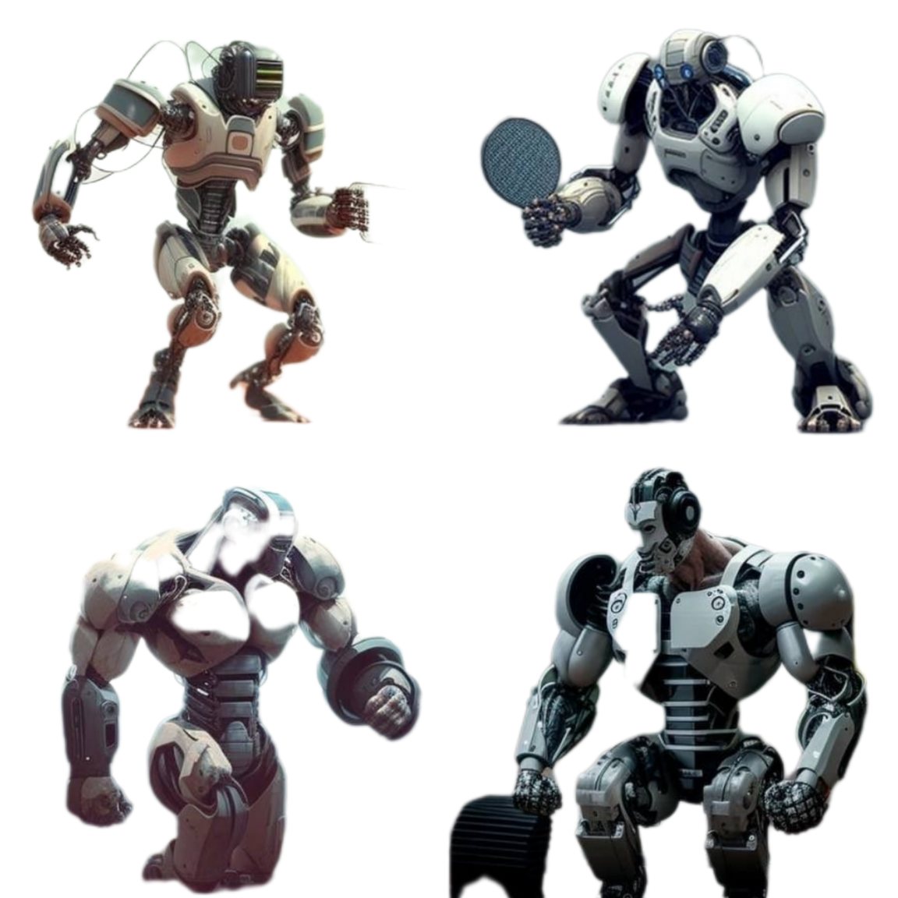
The target audience
1. SCHOOLS
2. SPORTS CLUB
3. INDIVIDUALS
INTERESTED IN TEACHING AND
IMPROVING THEIR
SPORTS SKILLS
A SPORTS ROBOT TEACHER
2023

Slide 3
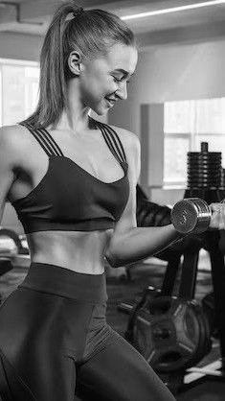
Better than human?
Would a sports robot teacher be a better teacher than a human?
First, it will have the ability to analyse and give feedback on a player's performance in real time, which would be impossible for a human coach.
Second, the robot will be able to provide individual training programmes for each individual based on his strengths and weaknesses, which would be difficult for a human coach.
Finally, the robot will be available always, providing continuous training and support to players.
A SPORTS ROBOT TEACHER
2023

Slide 4
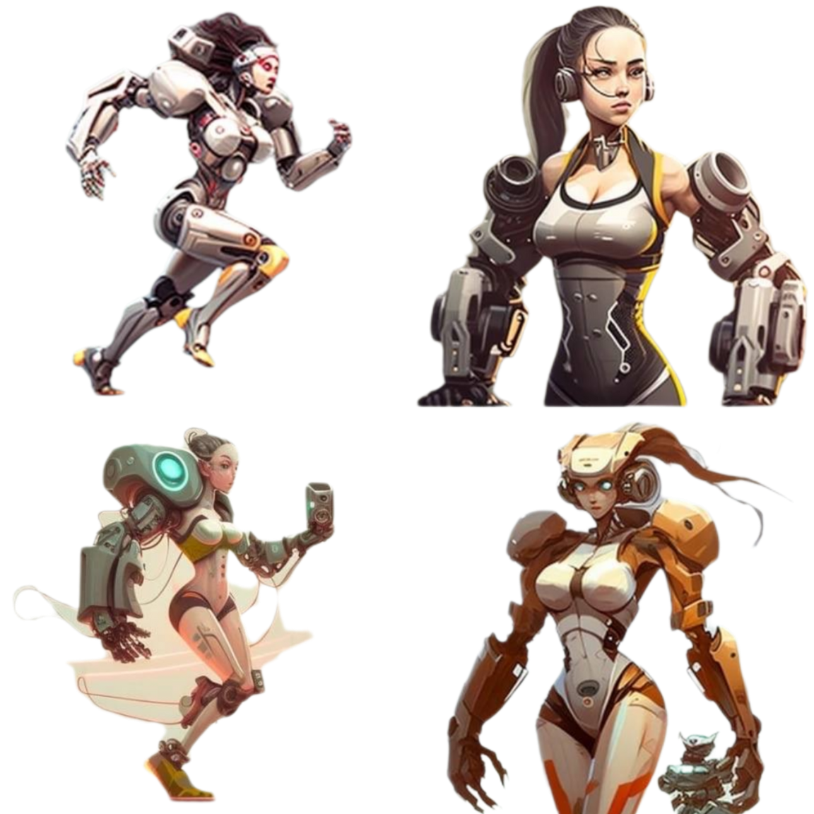
Technical specifications
1. STATE- OF- THE- ART SENSORS AND
CAMERAS
2. AI SYSTEMS
3. VOICE COMMANDS
4. VISUAL DISPLAYS
A SPORTS ROBOT TEACHER
2023

Slide 5
Design concept #1
A SPORTS ROBOT TEACHER
2023

Slide 6
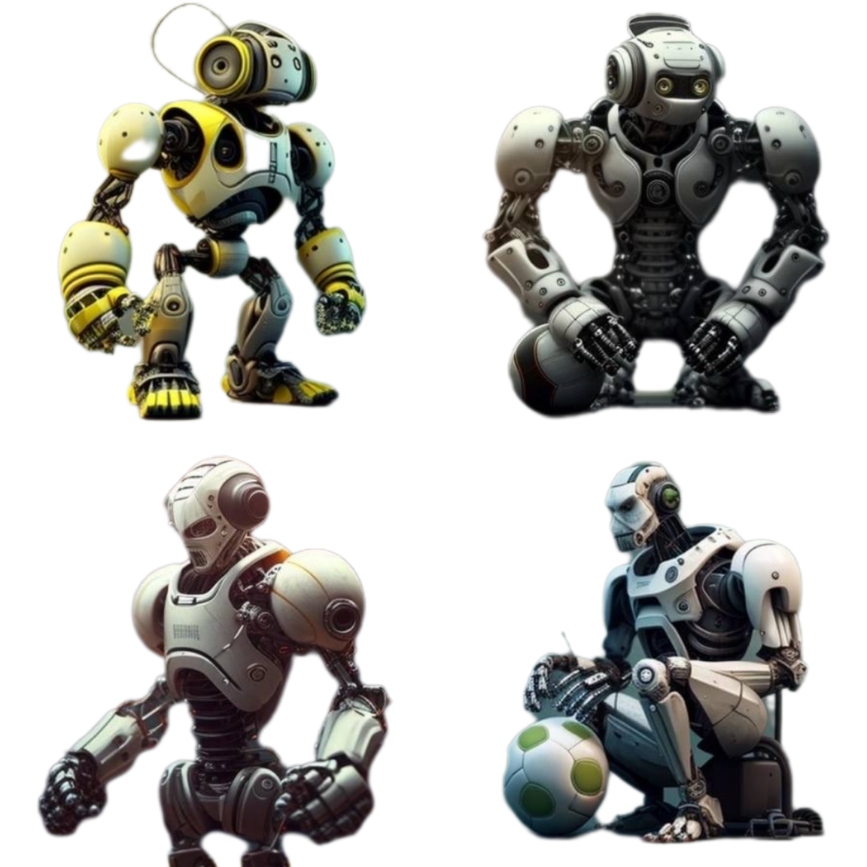
Design concept #2
A SPORTS ROBOT TEACHER
2023

Slide 7
Design concept #3
A SPORTS ROBOT TEACHER
2023

Slide 8
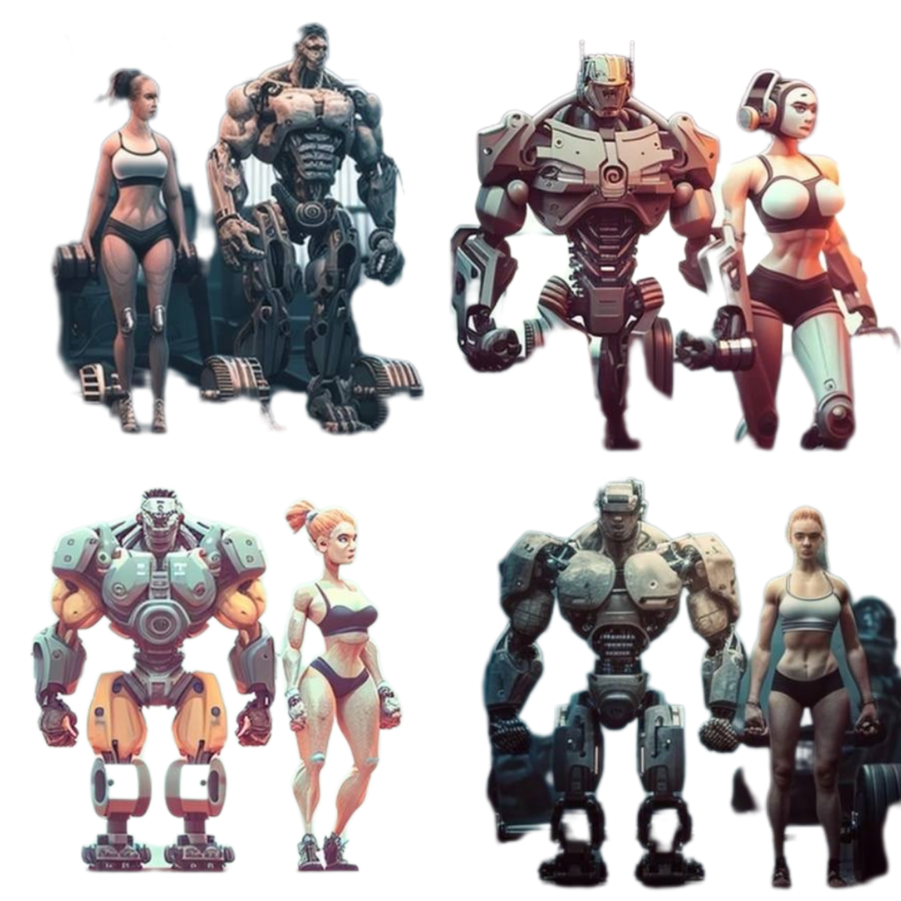
Design concept #4
A SPORTS ROBOT TEACHER
2023

Slide 9
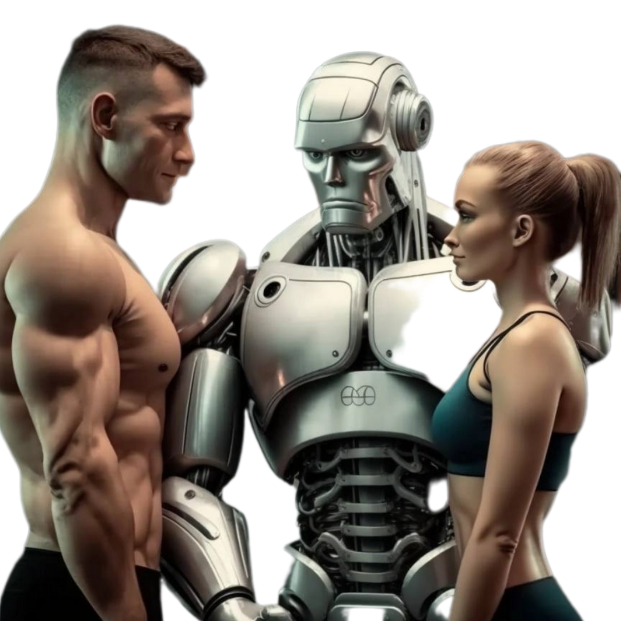
Slogan
...?
WHAT WILL THE SLOGAN SOUND LIKE?
The sports teacher robot can be promoted through social media campaigns, targeted advertising and partnerships with sports clubs and schools. The slogan could be:
Achieve your full potential and master your skills with the always support, real-time feedback, and customized training programs provided by the revolutionary sports teacher robot
A SPORTS ROBOT TEACHER
2023

Slide 10
Benefits
01.
Improved results
02.
Improving players' technique
03.
Personalised training programmes
04.
Ongoing support and feedback
05. Time saving and 06. Cost savings for sports clubs
and schools
2020

Slide 11
Thank you for your attention!
A sports robot teachers will change sports!
A SPORTS ROBOT TEACHER
2023

